Slide 1
Statistics 103
Monday, July 10, 2017

Slide 2
Survival Analysis
Survival analysis takes into account the time to the outcome and has several advantages over “snapshot”-in-time methods (e.g., odds ratios, relative risk ratios)
  It incorporates data from the entire survival curve and not just one arbitrary point (e.g., after 5 years, or the time to median survival)
  It incorporates data from patients that are lost to follow up or who die of unrelated causes before the study ends
  It incorporates data from patients who have not had the outcome yet at the end of the study because they enrolled in the study late or the study ended early

Slide 3
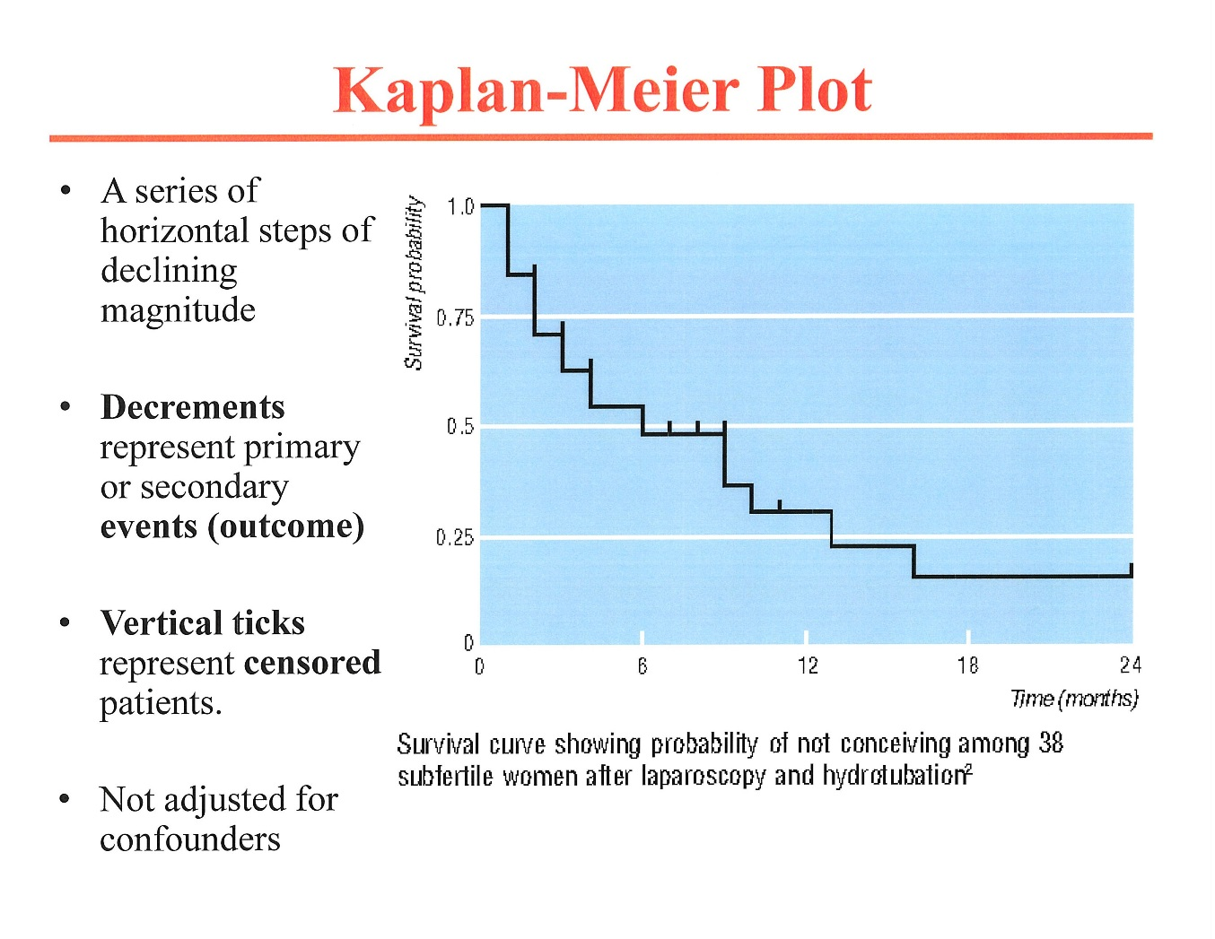
(covariates, as in the Cox model)

Slide 4
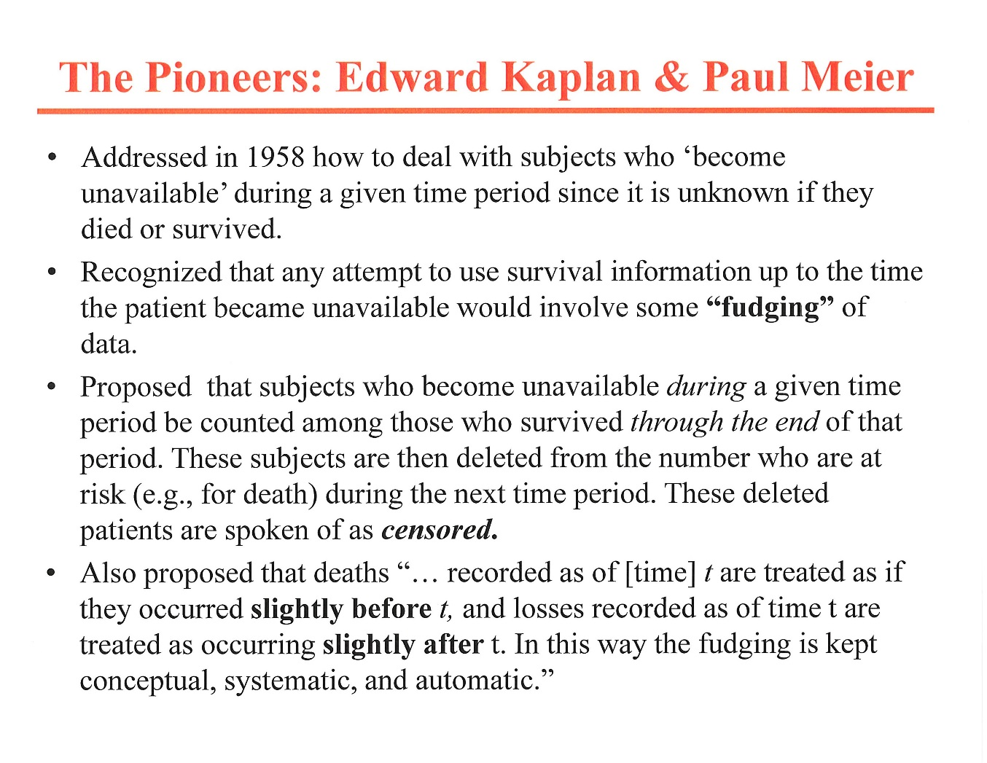

Slide 5
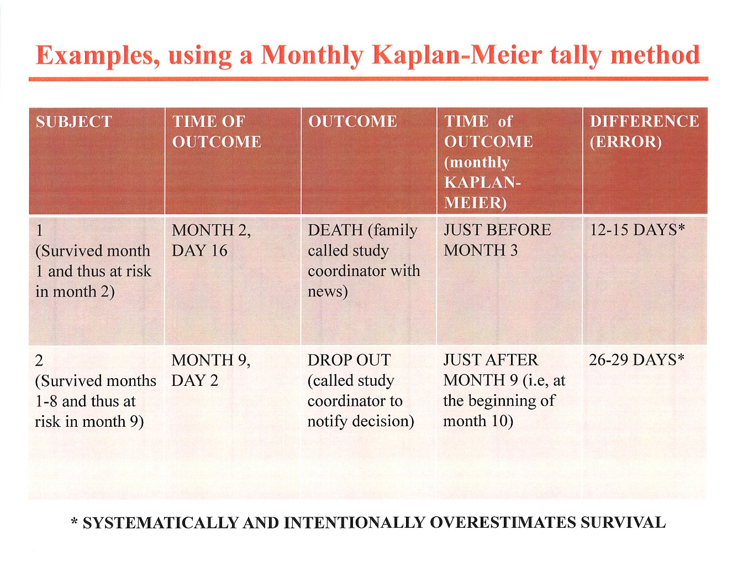

Slide 6
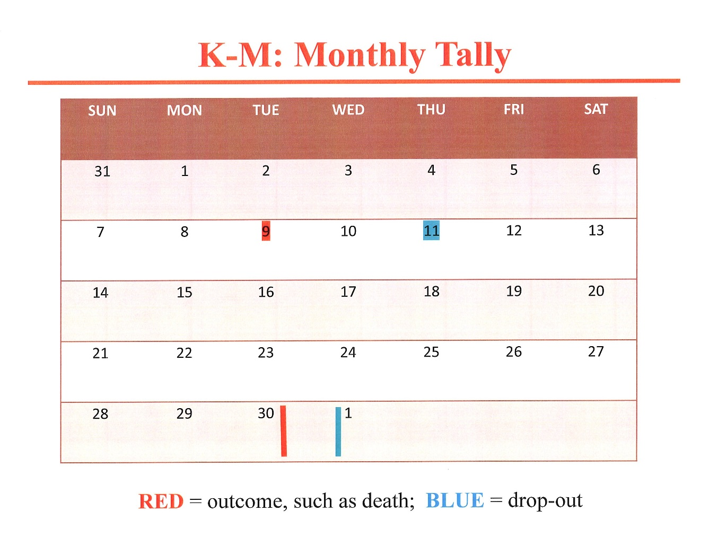
Could reduce
inaccuracy
by doing
weekly or
even
daily tally.

Slide 7
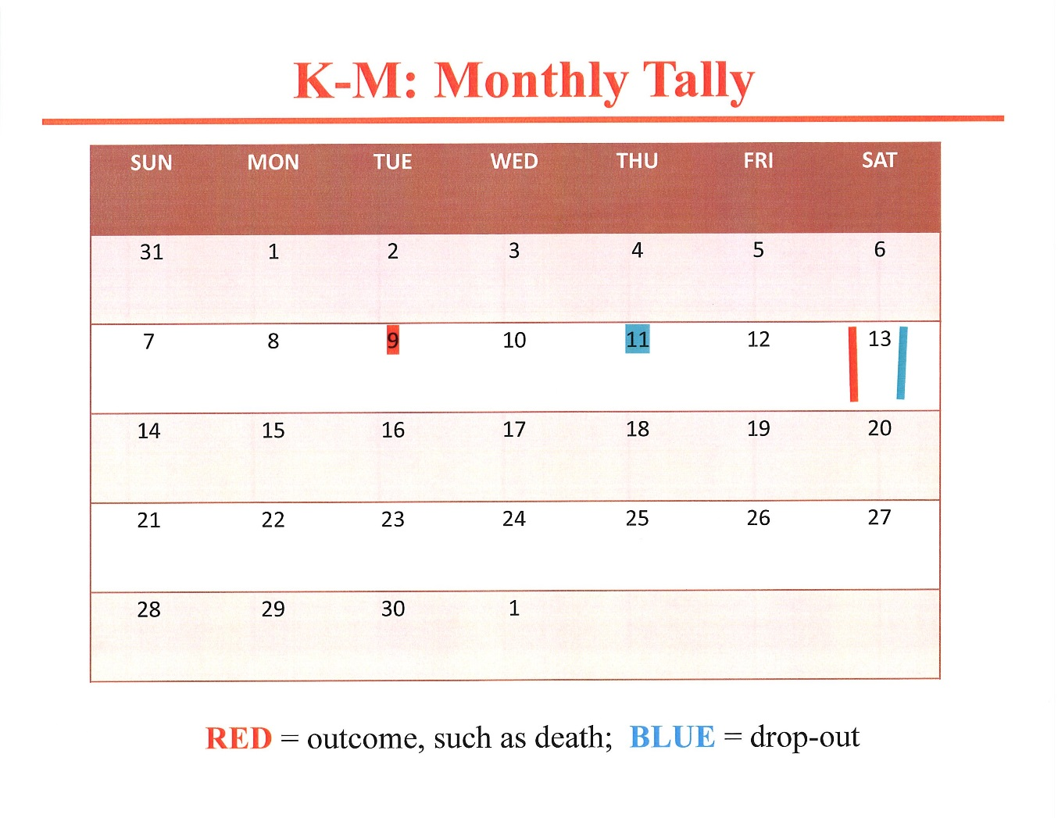
K-M: Same data, but Weekly tally
Wk1
2→
3
4
5

Slide 8
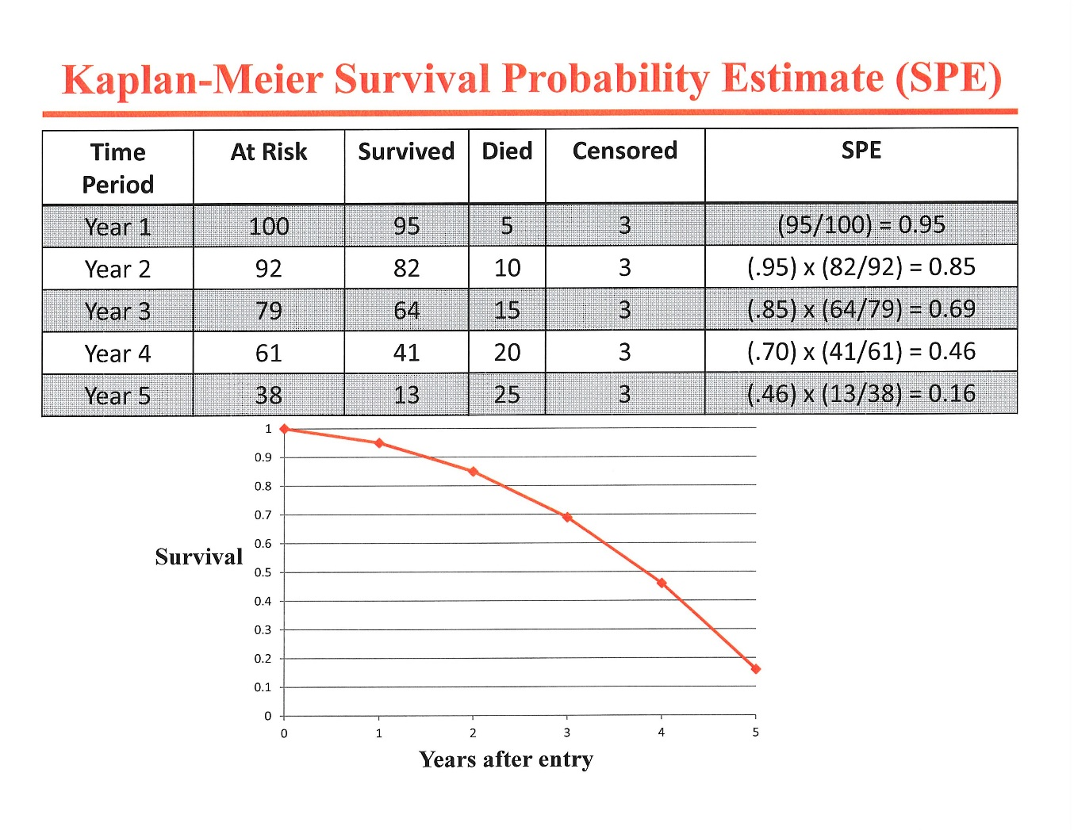
SPE
95/100= .95
.95x(82/92)=.85
.85x(64/79)=.69
.69x(41/61)=.46
.46x(13/38)=.16
(YEARLY TALLY)

Slide 9
Comparing Two Survival Curves (K-M)
Kaplan-Meier method: explores effect of one variable on survival using the log rank test or the Mantel-Haenszel approach, with nearly identical results. Log rank test:
  Compares Observed vs. Expected Outcomes in 2 X 2 table and a chi square test is done
  Null hypothesis (H₀): Observed Outcomes = Expected Outcomes, or Observed – Expected=0
  If chi-square statistic > critical value, then null hypothesis is rejected

Slide 10
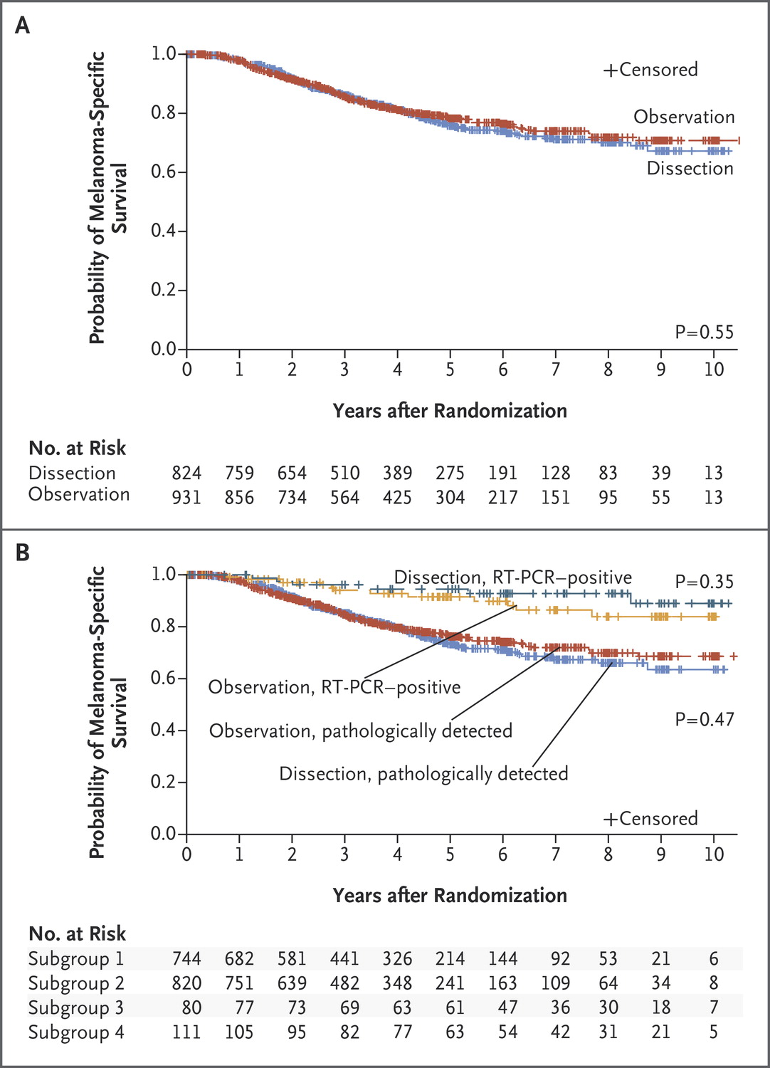
K-M PLOT
N’

Slide 11
Time-to-outcome analysis using log-rank test
Chan FKL et al. Lancet 2017: 389: 2375-82
N’

Slide 12
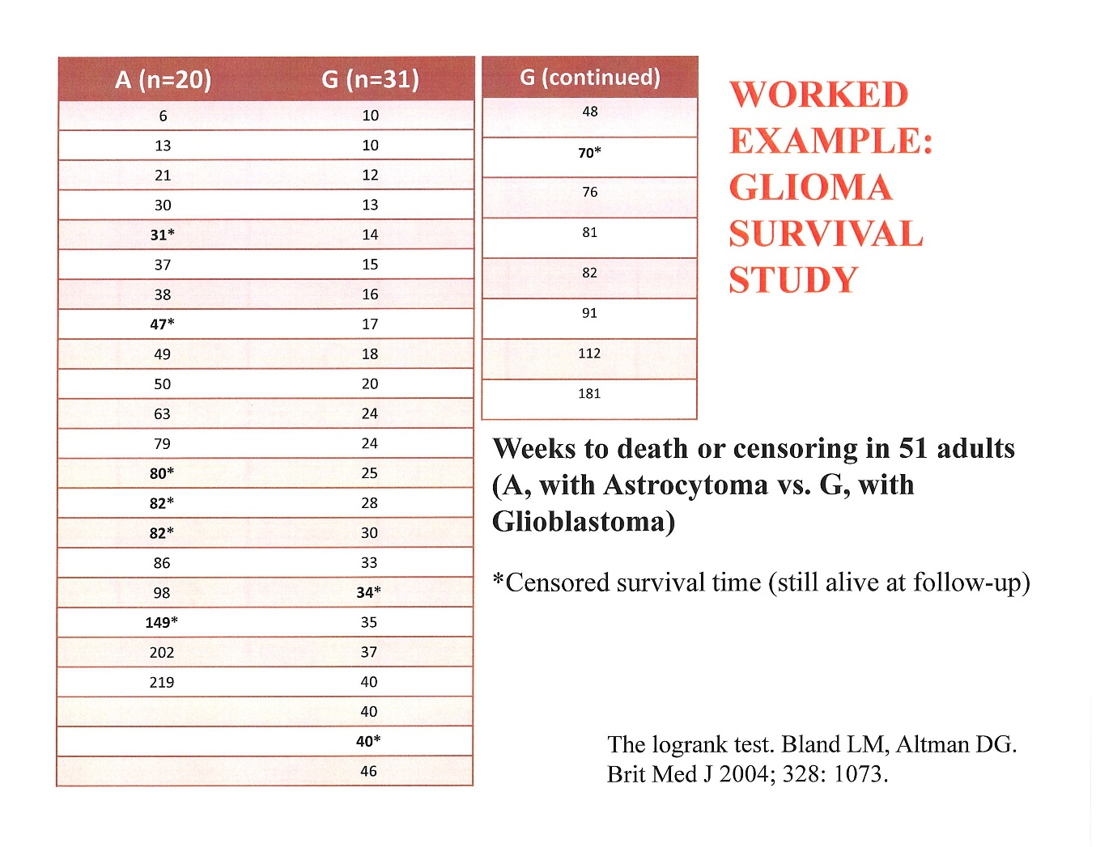
KAPLAN-MEIER METHOD USING LOG RANK TEST TO OBTAIN P-VALUE
WEEKLY TALLY
Patients were followed until censored, death, for 219 weeks

Slide 13
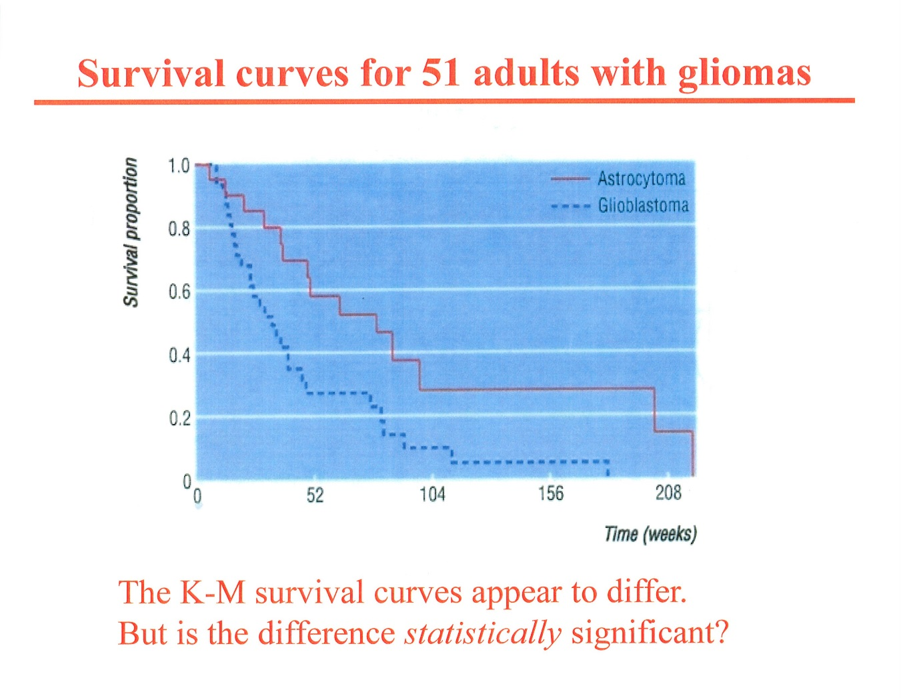
Use log rank test to determine this

Slide 14
Log rank test:
Observed (O) vs Expected (E) Outcomes over time as basis for Kaplan-Meier
    O_{group 1} =a ΣE_{group 1} =b
    O_{group 2} =c ΣE_{group 2} =d
TIME (WK) | N'1 | N'2 | O 1 | O 2 | E 1 | E2
START | 40 | 60
1 | 40 | 60 | 0 | 1 | 0.4 | 0.6
2 | 40 | 59 | 2 | 0 | 0.8 | 1.2
3 | 38 | 59
N’
2X2 Table for chi square test
a b
c d
Σ_{1-i} , sum of the outcomes over the time periods 1 to i
etc. and then do Σ for each column to determine a,b,c,d

Slide 15
SEE HANDOUT A
LOG RANK TEST FORMULA:
  (ΣO1-ΣE1)² ÷ ΣE1 + (ΣO2- ΣE2)² ÷ ΣE2 = CHI-SQUARED VALUE
  Σ(a-b)²/b + Σ(c-d)²/d
  If Σ(a-b) and Σ(c-d) are close to zero, the chi squared value will beclose to 0
  The higher the chi square value, the more likely it is to be significant

Slide 16
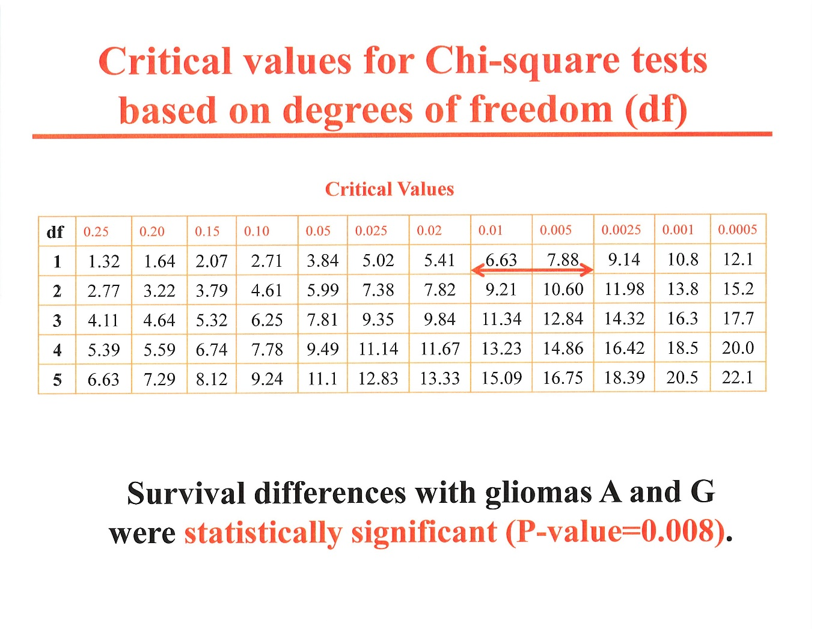
Degrees of freedom υ= N-1
With 2 groups, υ=1.

Slide 17
Cox proportional Hazards Regression
A method for investigating the effects of several variables upon the time a specific outcome takes to happen
These variables are assumed to have a multiplicative effect on risk

Slide 18
Comparison Two Survival Curves (Cox model)
Cox proportional hazards model: explores multiple variables using the hazards ratio (HR)
  Compares the ratio of Observed to Expected outcomes in one group to another, taking multiple confounding variables into consideration
  Null hypothesis (H₀): that the HR of Observed Outcomes to Expected Outcomes in the first group to those of the second group = 1
  If 95% CI of the HR does not overlap a ratio of 1, the null hypothesis is rejected

Slide 19
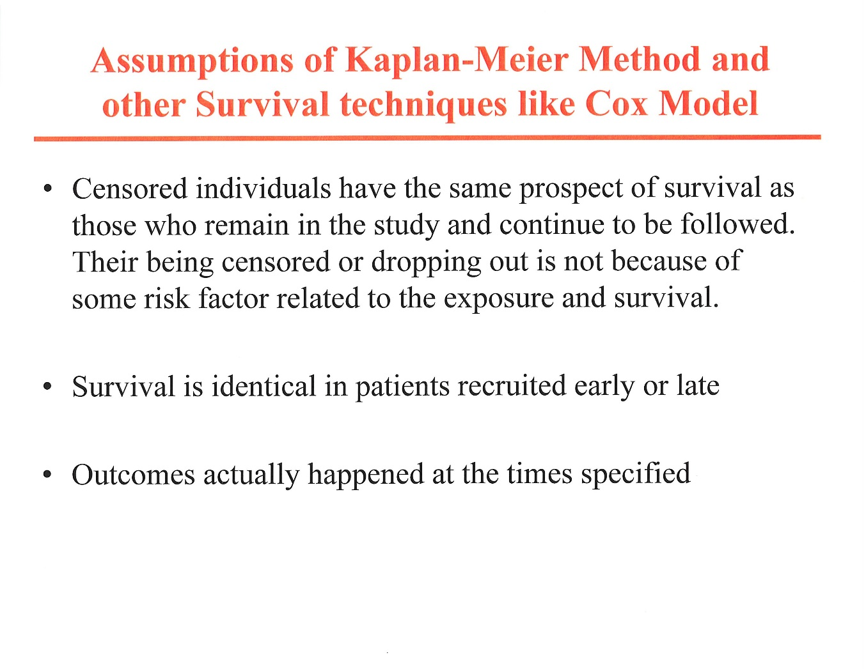
Distribution of time-to-event measure is exponential (i.e., the event rate is constant over time, with fluctuations due to random variability only)

Slide 20
Hazard rate
The risk of failure (i.e., the risk of suffering the event of interest), given that the participant has survived up to a specific time.
Hazard rate for a time period t is generally expressed as h(t) and can range from 0 to 1
  e.g., for patients surviving the first 2 months, hazard rate for month 3 may be 0.05

Slide 21
Hazard ratio (HR)
Conceptually, hazard rate_{exposed} / hazard rate_{unexposed}
Mathematically:
  HR= h(t) /h_{o}(t) = exp (b₁x₁+b₂x₂+…+b_{p}X_{p}),
    where h₀(t) is the baseline risk of the endpoint with no predictors present (i.e., unexposed)
    x₁, x₂, etc. are predictors of risk (independent variables predicting outcome)
    b₁, b₂, etc. are Cox coefficients (parameter estimates); For example, b₁ represents the log of the hazard ratio relative to one (1) unit of change in x₁, holding all other predictors constant
      + b₁ → increased risk of outcome (e.g, b₁= +.2)
      - b₁ → decreased risk of outcome (e.g., b₁= -.05)
  Ln HR= ln [h(t)/h₀(t)]= b₁x₁+b₂x₂+…+b_{p}X_{p}

Slide 22
Cox proportional hazards regression model
5,180 Framingham participants, age 45-82 , followed until death or for 10 years. Baseline age, sex, SBP, smoking, cholesterol, and DM recorded.
There were 402 deaths (events, outcomes).
RISK FACTOR | b (parameter estimate) | P value | HR (95% CI)
X₁= age, years | 0.11691 (b₁) | 0.0001 | 1.124 (1.111-1.138)
X₂= male sex | 0.40359 (b₂) | 0.0002 | 1.497 (1.215-1.845)
X₃=SBP | 0.01645 (b₃) | 0.0001 | 1.017 (1.012-1.021)
X₄=current smoker | 0.76798 (b₄) | 0.0001 | 2.155 (1.758-2.643)
X₅= total serum cholesterol | -0.00209 (b₅) | 0.0963 | 0.998 (.995-1.002)
X₆= diabetes mellitus | -0.02366 (b₆) | 0.1585 | 0.816 (.615-1.083)
If x₂=x₃=x₄=x₅=x₆=0, and x₁=1 (age 46), then ln (h(t)/h₀)=b₁⋅1 and h(t)/h₀= e^{b1} =e^{.11691} = 1.124

Slide 23
Cox regression model if there is only one independent variable of interest (e.g., treatment or cancer stage)
Ln HR= ln [h(t)/h₀(t)]= b₁x₁
Becomes similar to the Kaplan-Meier method except that it uses Observed-Expected ratios in the two groups rather than differences between Observed and Expected in the two groups
ΣO1/ΣE1÷ ΣO2/ ΣE2
Often referred to as the crude hazard ration, as there are no covariates other than the outcome in question

Slide 24
Cox regression model if there is only one independent variable of interest (e.g., treatment or cancer stage)
80 patients with DH Lymphoma were followed until death (EVENT) or for up to 1 year without therapy to assess survival differences in cancer stage 3 vs stage 4
54 EVENTS occurred during the follow up period
SEE HANDOUT B

Slide 25
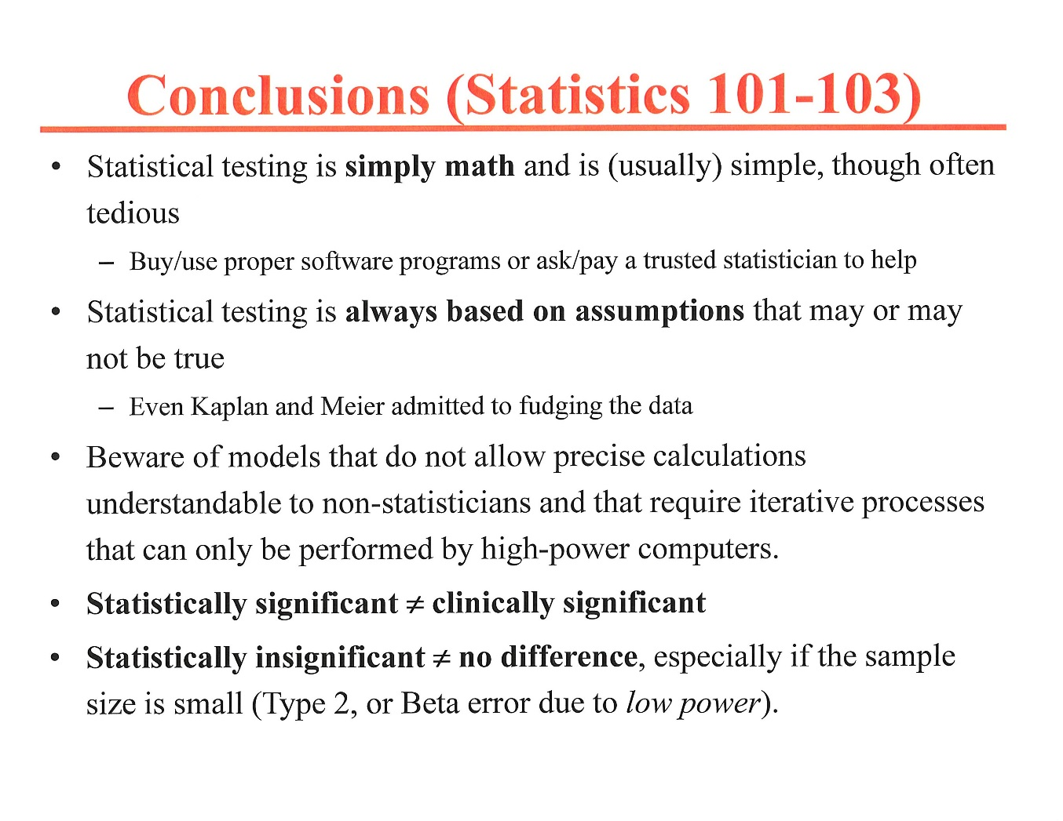

Slide 26
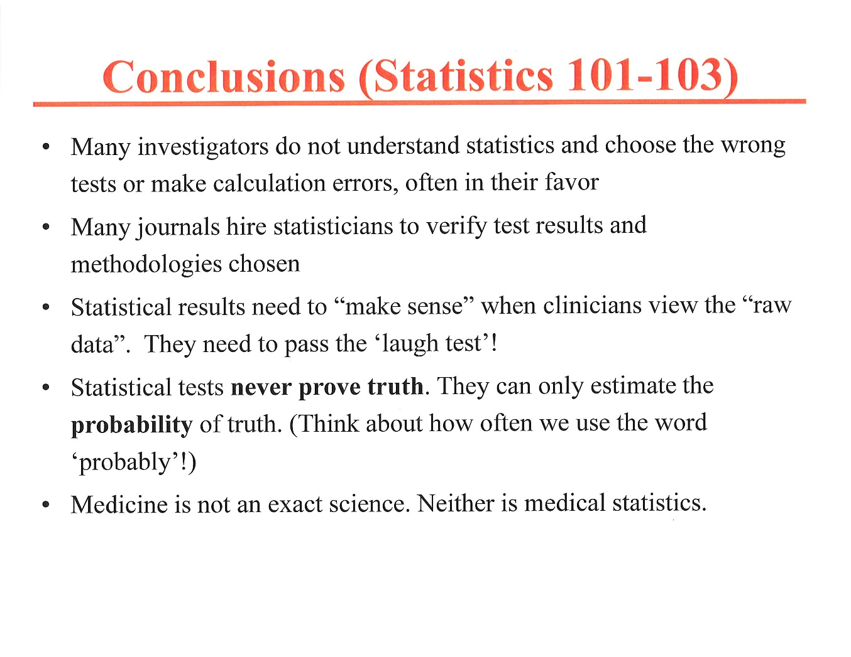

Slide 27
Final take home point
It is impossible to ever know the true nature of the population from which we sample.
We can only take a sample from it, carefully measure the sample, and then calculate the probability that the sample was derived from a THEORETICAL population distribution
  For example, if p<.0001 vs. a theoretical normal distribution, it is VERY unlikely that the sample was derived from a normal (Gaussian) distribution.
Very low probability ≠ Certainty
  ABIM seat charting example

Slide 29
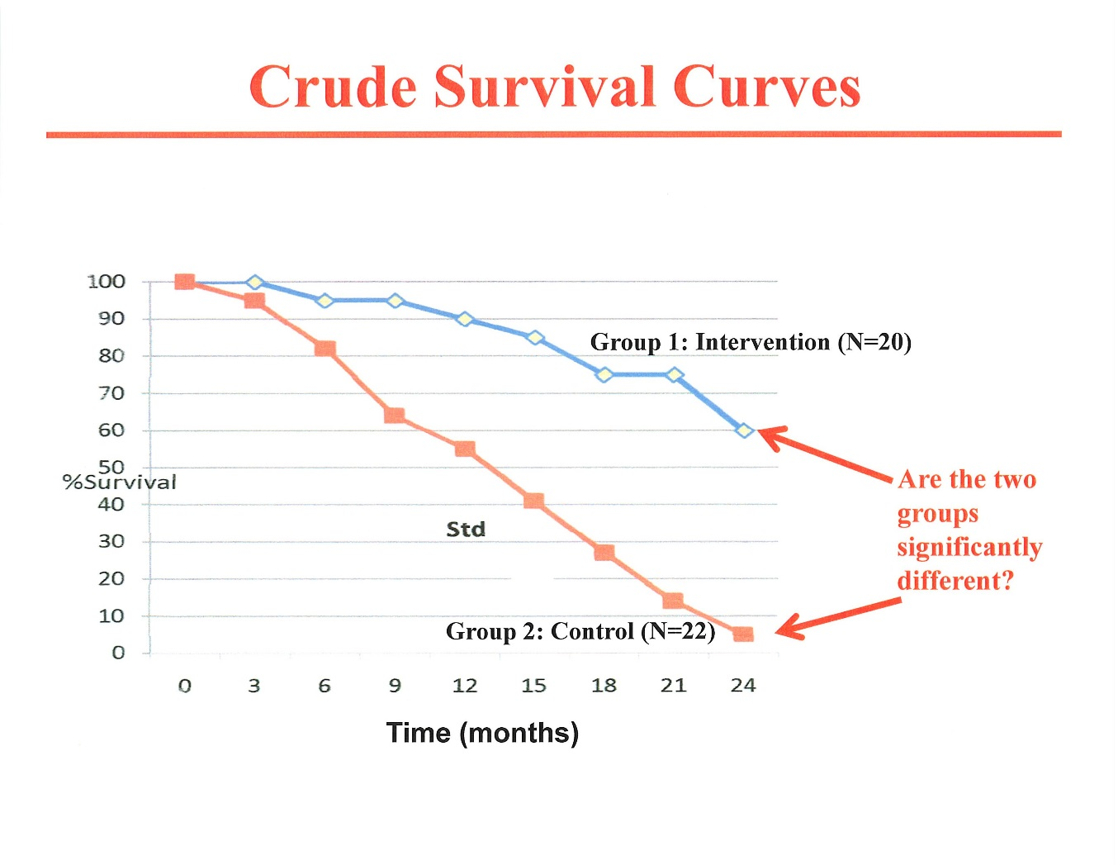

Slide 30
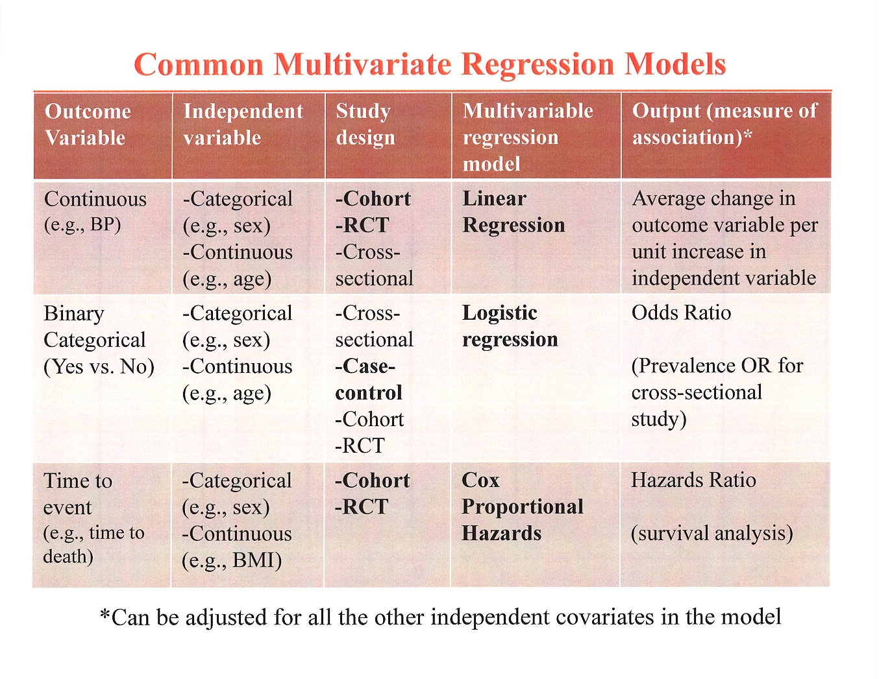

Slide 31
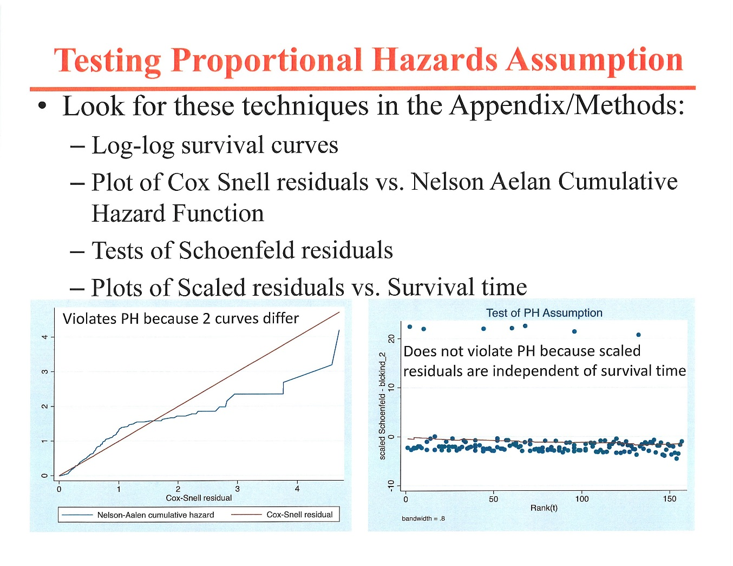

Slide 32
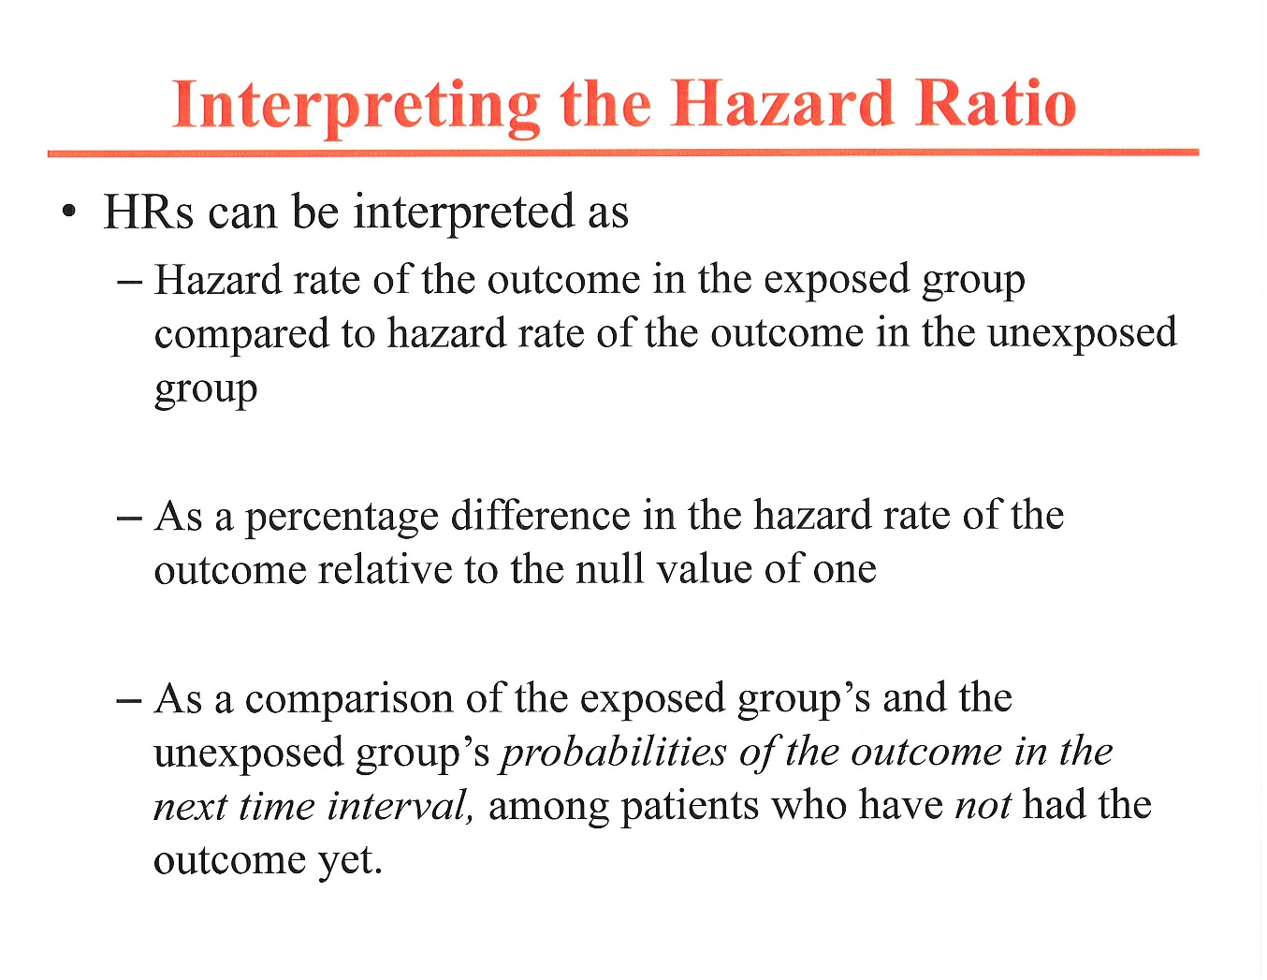

Slide 33
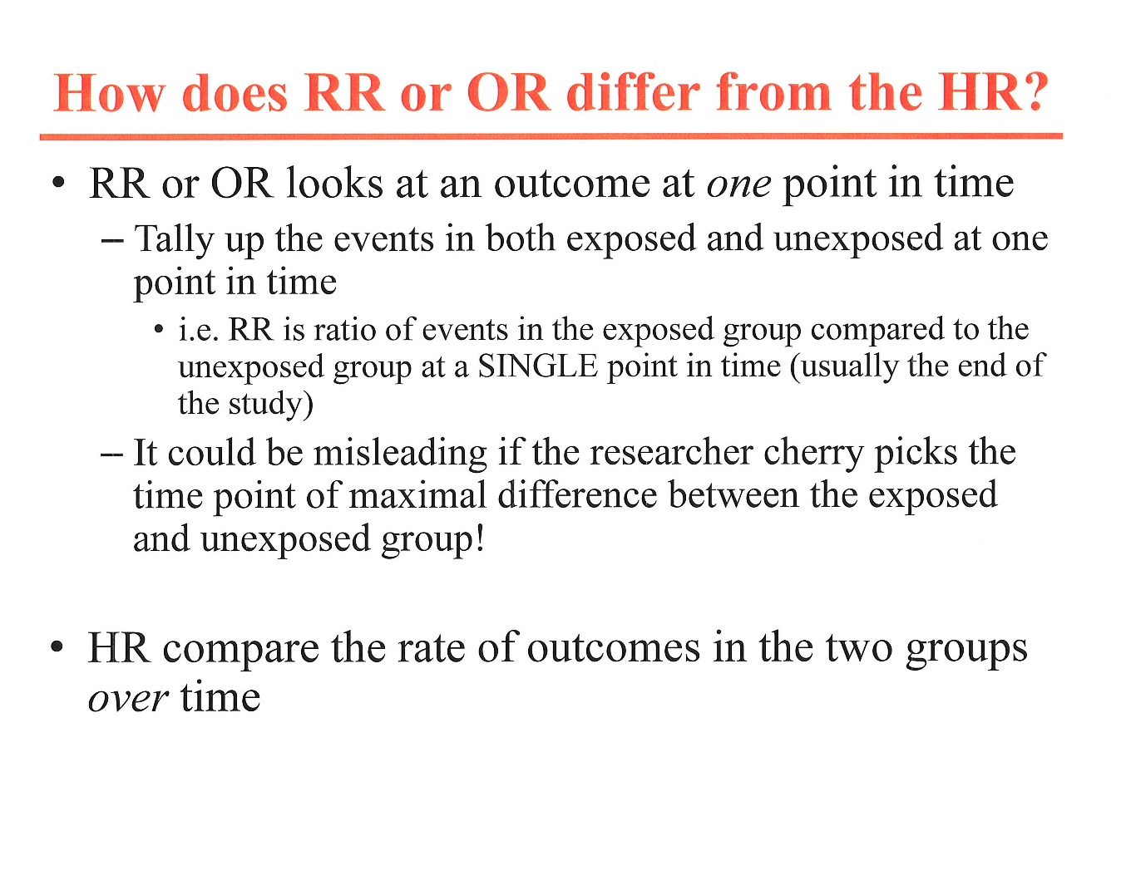

Slide 34
Survival Ratios
Odds ratio: compares outcome at one point in time
Risk ratio: compares outcome at one point in time
Median time ratio: compares outcome at one point in time
Hazards ratio: uses entire survival curve to assess outcomes
  Log rank test
  Cox proportional model

Slide 35
Comparison of hazard ratio and median time ratio
% CURE RATE OVER TIME
group 1 | 1 WEEK | 4 WEEKS | 8 WEEKS
A | 50% | 75% | 100%
B | 25% | 37.5% | 50%
HAZARD RATIO (B/A)= .5 (FAVORING group 1 A)
MEDIAN TIMES TO CURE:
group 1 A: 1 WEEK
group 1 B: 8 WEEKS
MEDIAN TIME RATIO (B/A)= .125 (FAVORING group 1 A)

Slide 36
Comparison of hazard ratio and median time ratio
group 1 | 3 MONTHS | 6 MONTHS | 1 YEAR | 2 YEARS | 3 YEARS
NEW | 90% | 60% | 20% | 5% | 1%
STANDARD | 45% | 30% | 10% | 2.5% | 0.5%
HAZARD RATIO FOR SURVIVAL: 2 WITH STANDARD group 1 VS. NEW group 1
MEDIAN SURVIVAL TIMES:
NEW: ≈7 MONTHS
B:≈ 2 MONTHS
DIFFERENCE: 5 MONTHS FOR A 3 YEAR STUDY
MEDIAN TIME RATIO: 3.5 FAVORING NEW group 1
%
MONTHS

Slide 37
Common multivariate regression models
OUTCOME VARIABES | INDEPENDENT VARIABLES | REGRESSION MODEL | OUTPUT (ASSOCIATION)
CONTINUOUS | CATEGORICAL OR CONTINUOUS | LINEAR REGRESSION | AVE. Δ IN OUTCOME PER UNIT ↑ IN INDEPENDENT VARIABLE
BINARY CATEGORICAL (YES OR NO) | CATEGORICAL OR CONTINUOUS | LOGISTIC REGRESSION | ODDS RATIO
TIME TO EVENT (e.g., time to death) | CATEGORICAL OR CONTINUOUS | COX PROPORTIONAL HAZARDS MODEL | HAZARDS RATIO

Slide 38
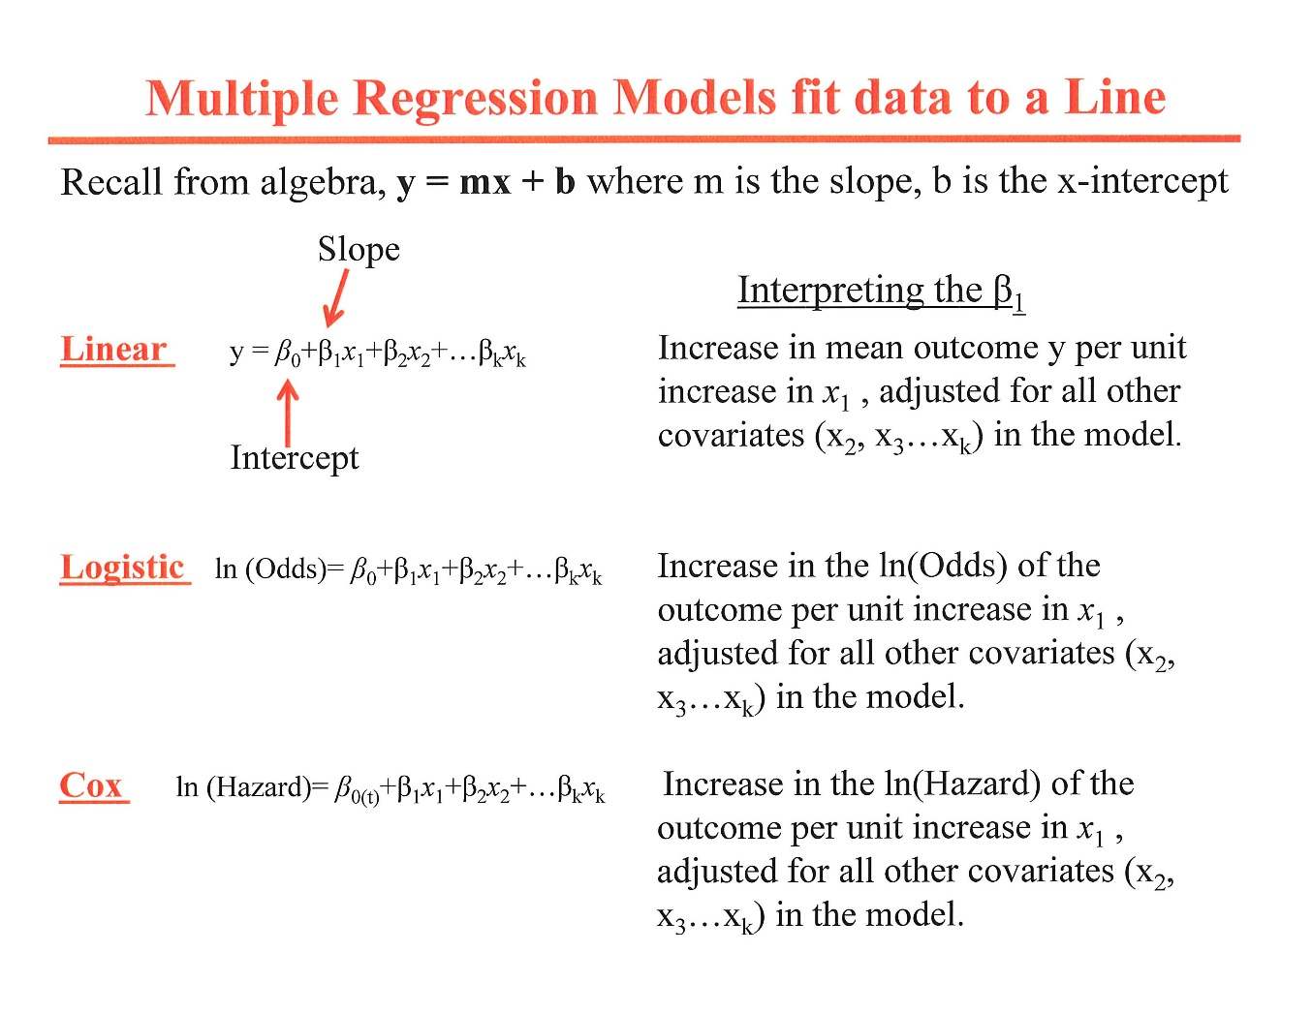

Slide 39
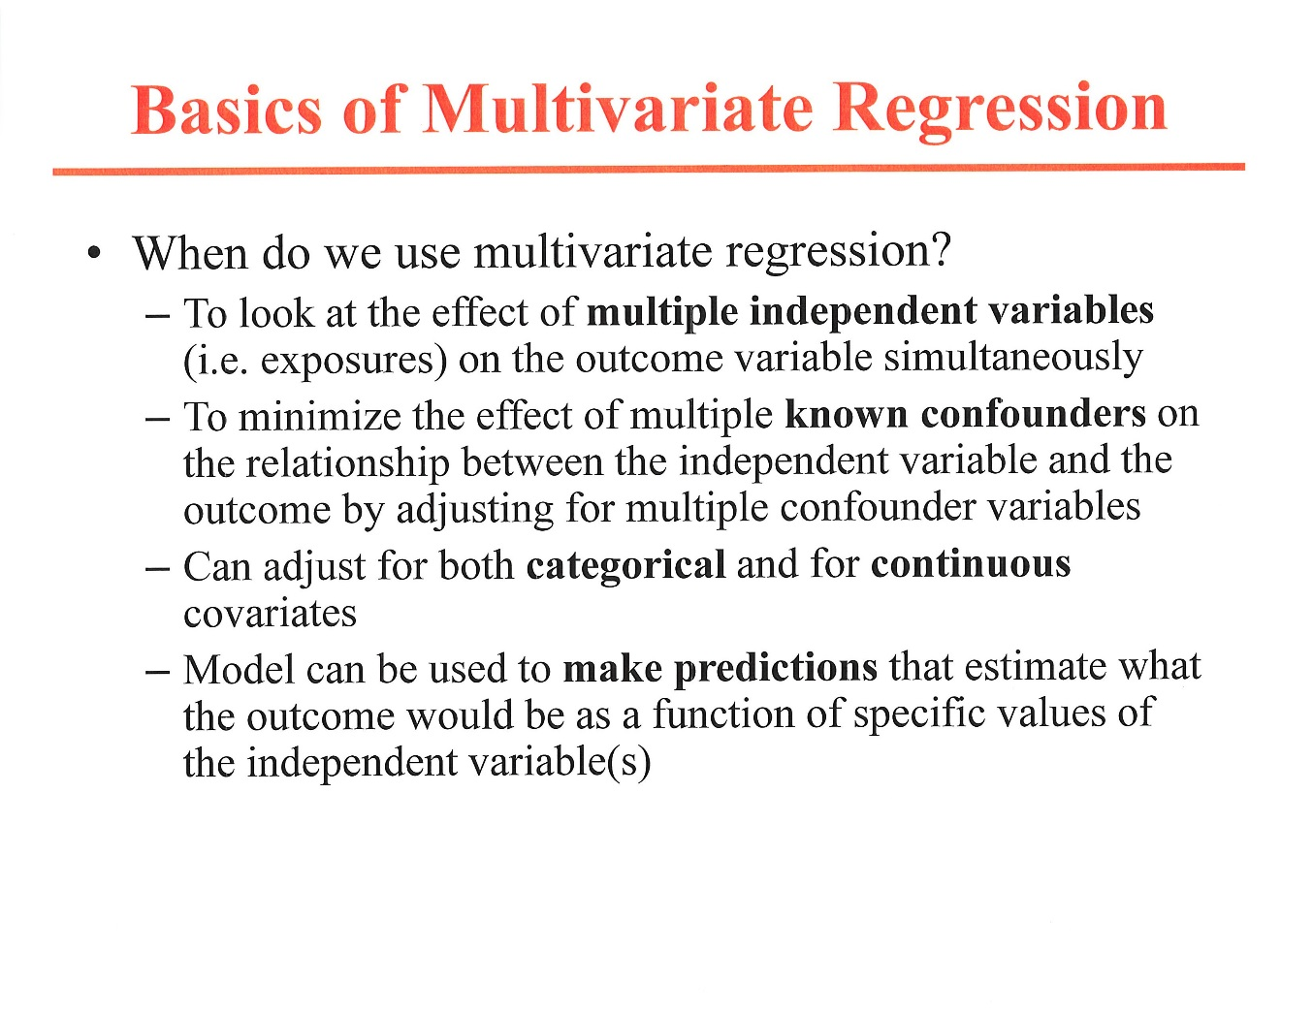

Slide 40
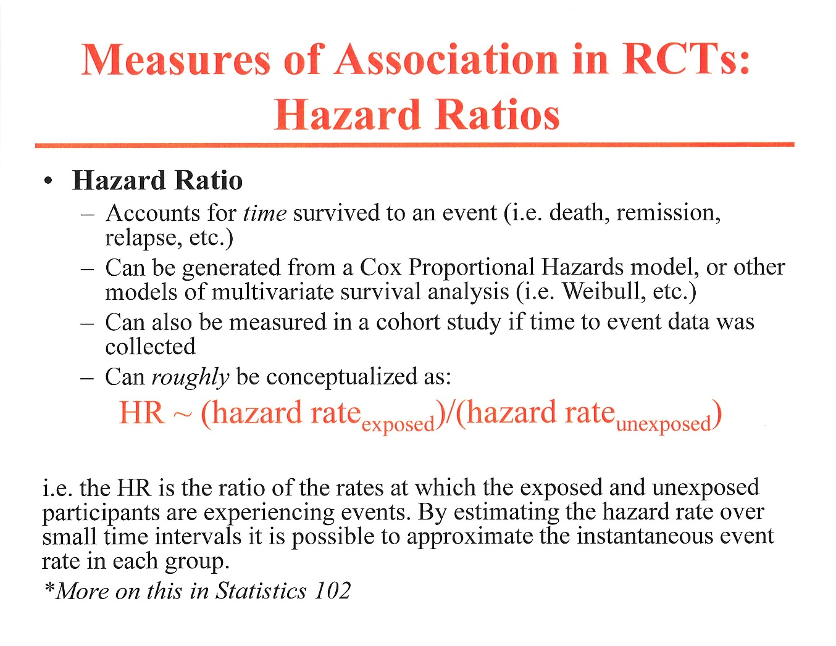
(HRs)

Slide 41
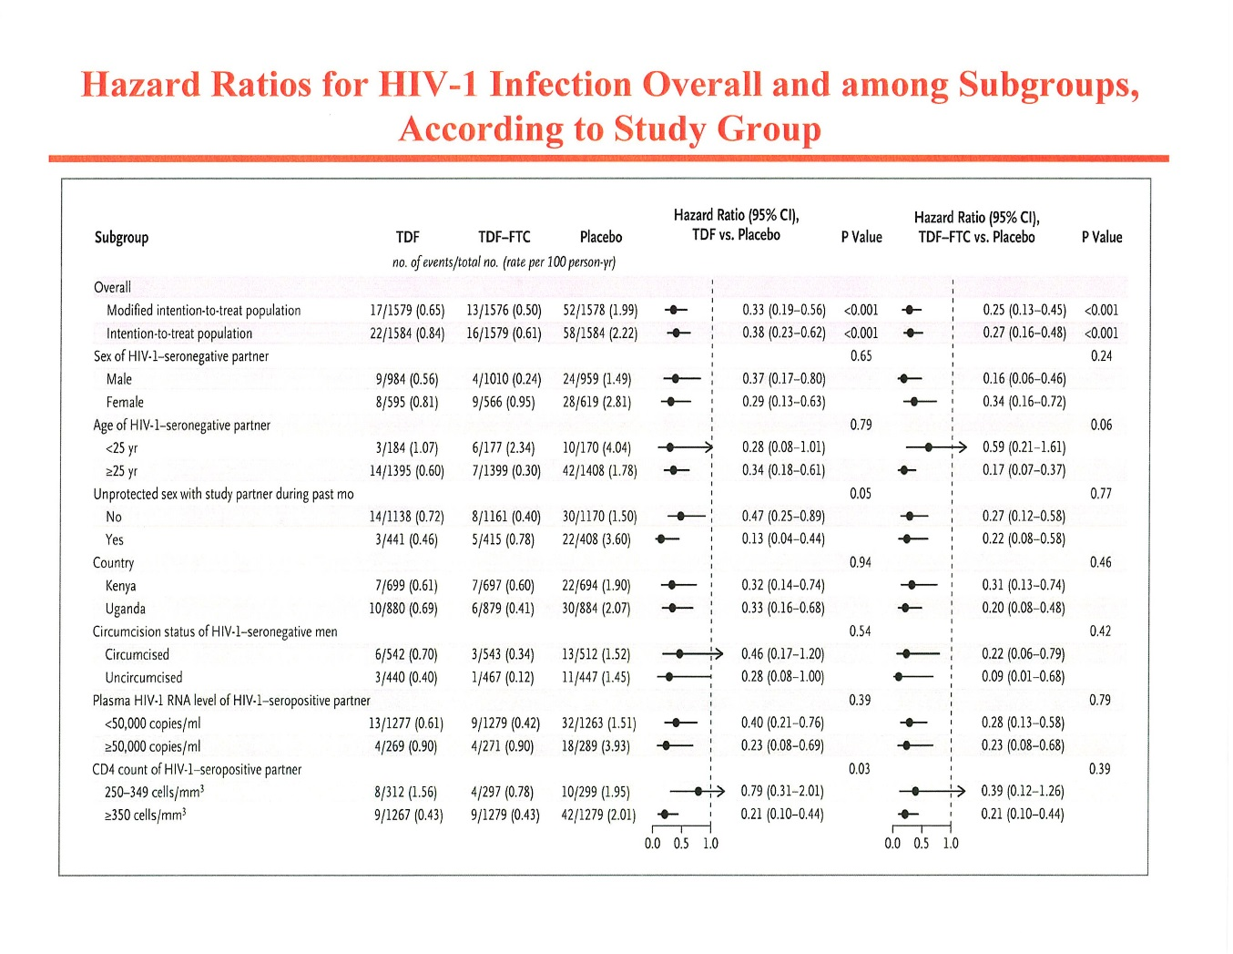

Slide 42
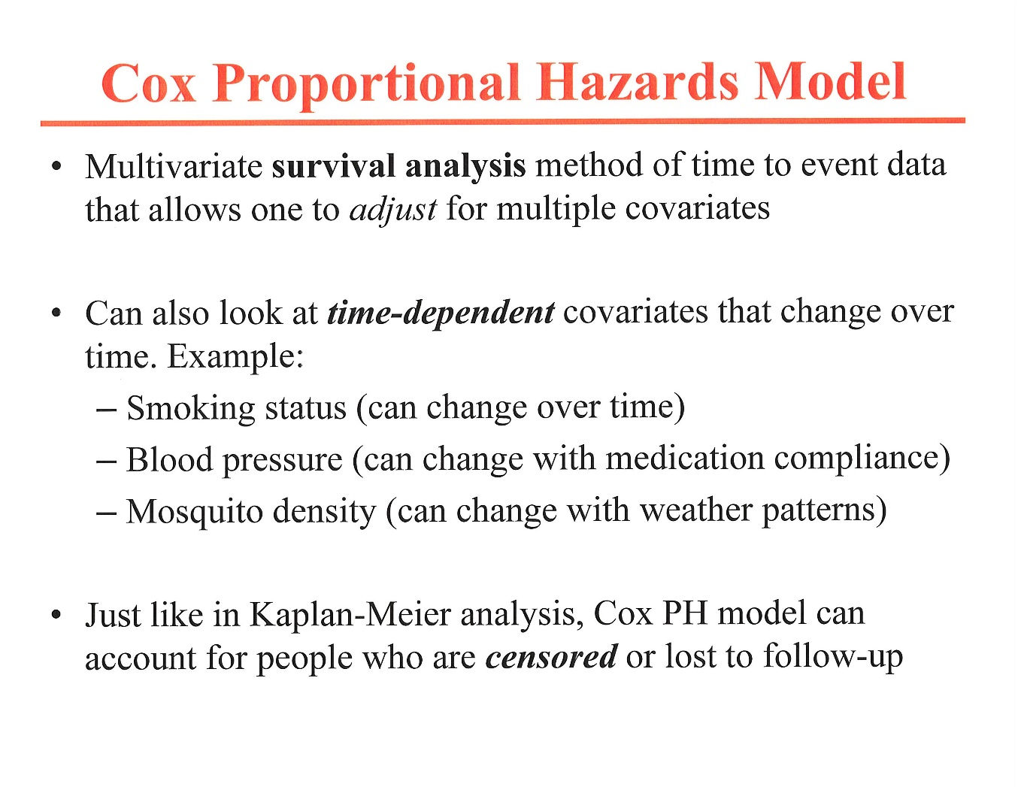

Slide 43
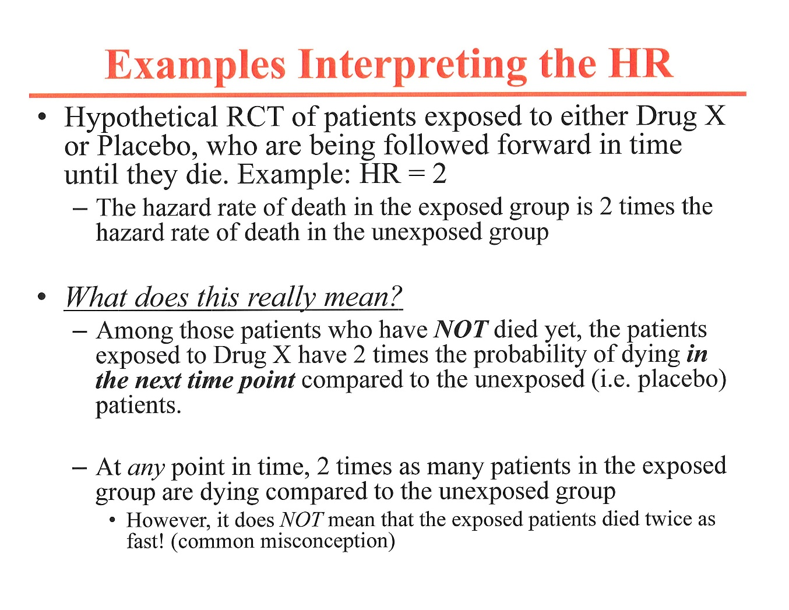

Slide 44
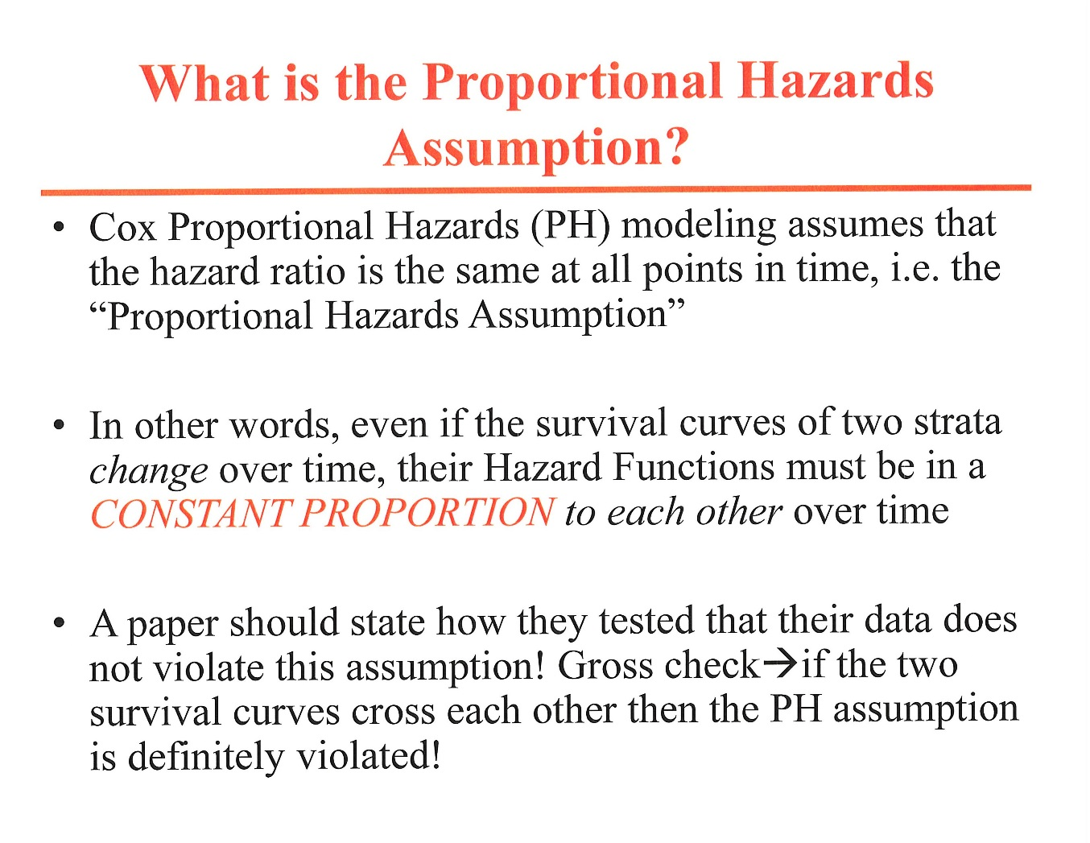

Slide 45
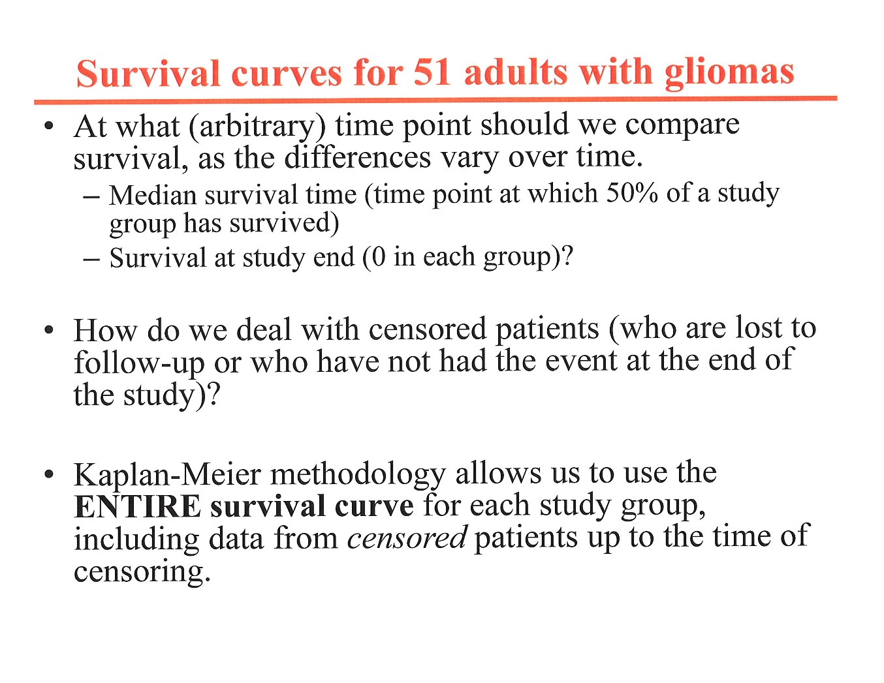

Slide 46
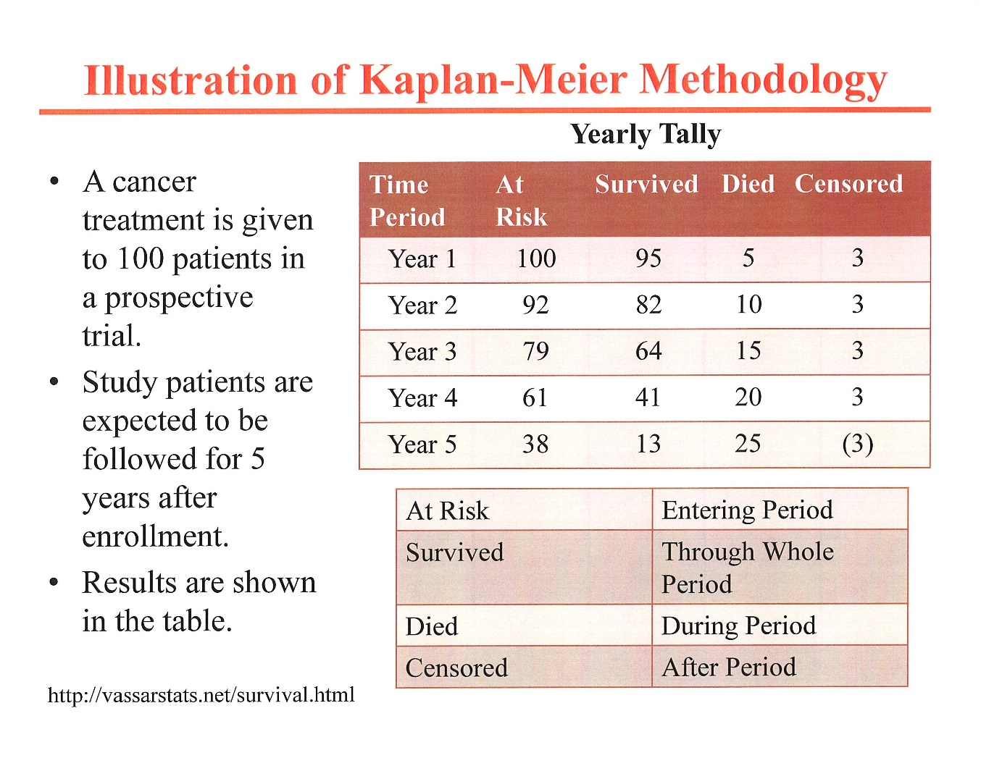

Slide 47
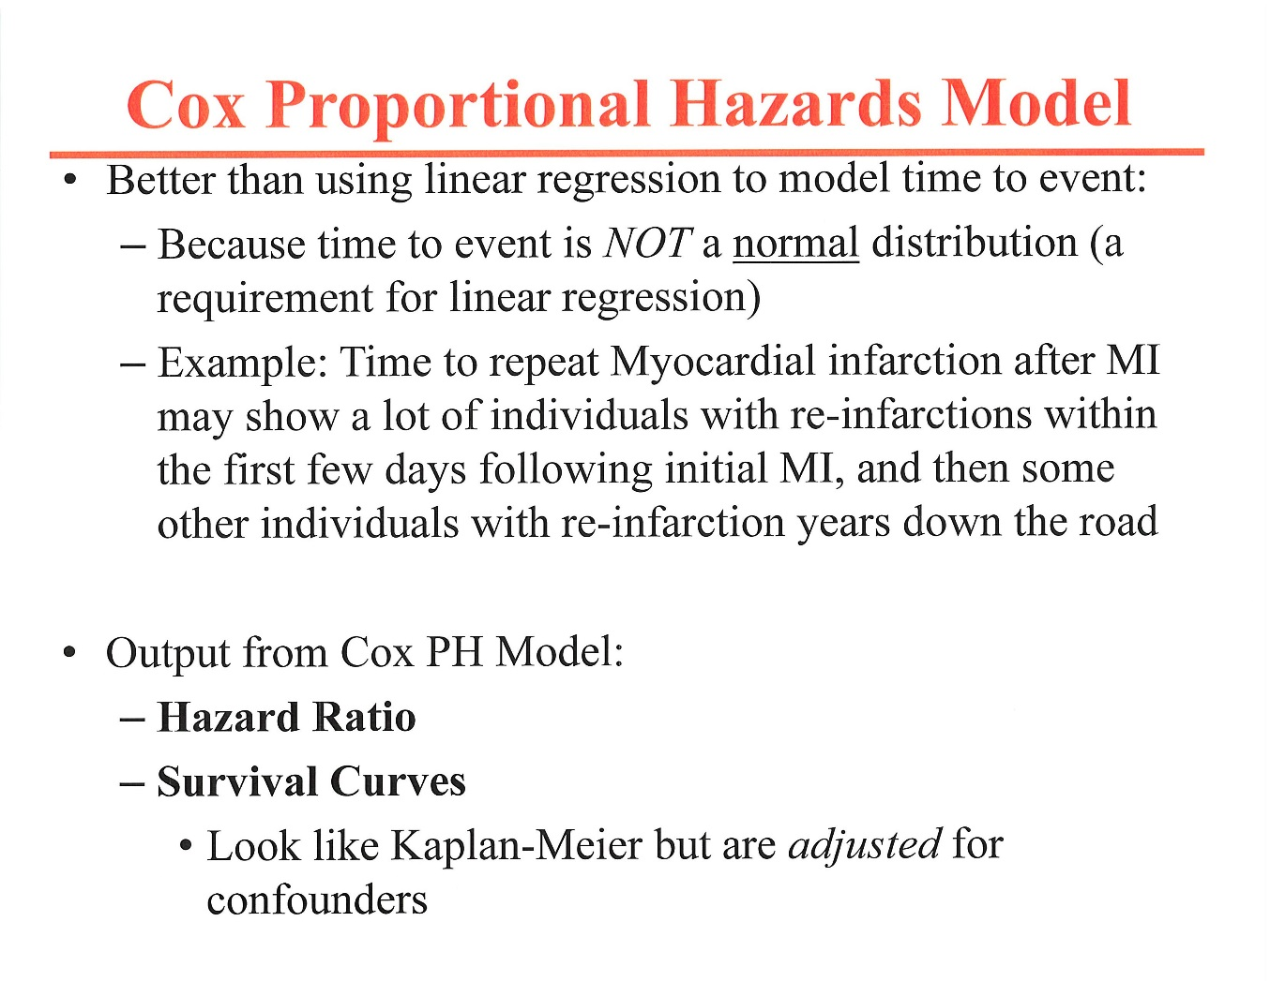

Slide 48
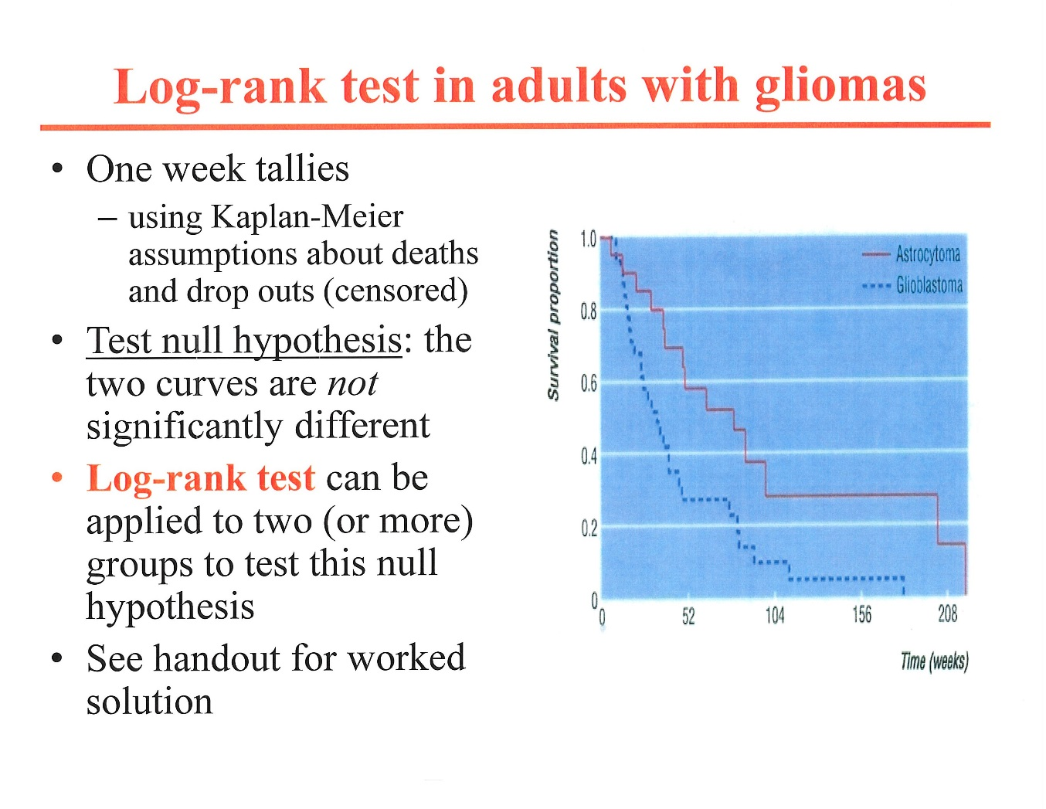
*
* i.e., Observed Outcomes= Expected

Slide 49
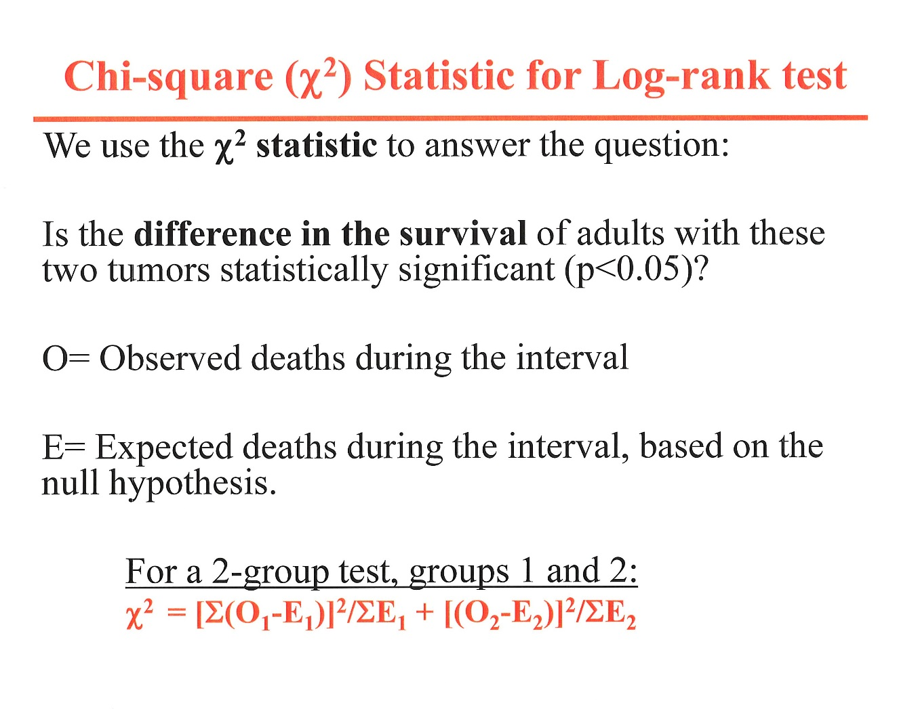
i, where I = 1 to n weekly intervals
χ² = [Σ(O₁-E₁)]²/ΣE₁ + [Σ(O₂-E₂)²/ΣE₂

Slide 50
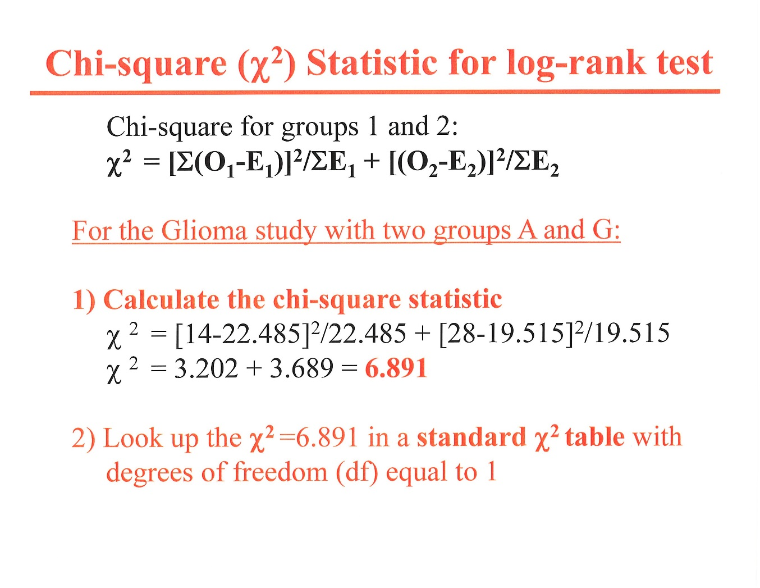
(of sizes n=20 and n=31)
χ² = [Σ(O₁-E₁)]²/ΣE₁ + [Σ(O₂-E₂)²/ΣE₂

Slide 51
“Shortcut” using the median survival ratios*
(avoids long computations or need for SPSS or SAS programs)
Median survivals:
  Astrocytoma, 80 weeks (14 deaths)
  Glioblastoma, 34 weeks (28 deaths)
  Median hazard ratio (HR) = 80/34=2.35, and ln HR=0.85
95% CI for HR
  SE for ln HR = √1/14 + 1/28 = .3273
  95% CI for ln HR= ln HR± 1.96SE= .85±.6415= .2085,1.325
  exp .2085, exp 1.335= 1.23. 3.76
  Thus, HR = 2.35 (1.23,3.76), with P = .01
* estimates p-value, but not quite as accurate

Slide 52
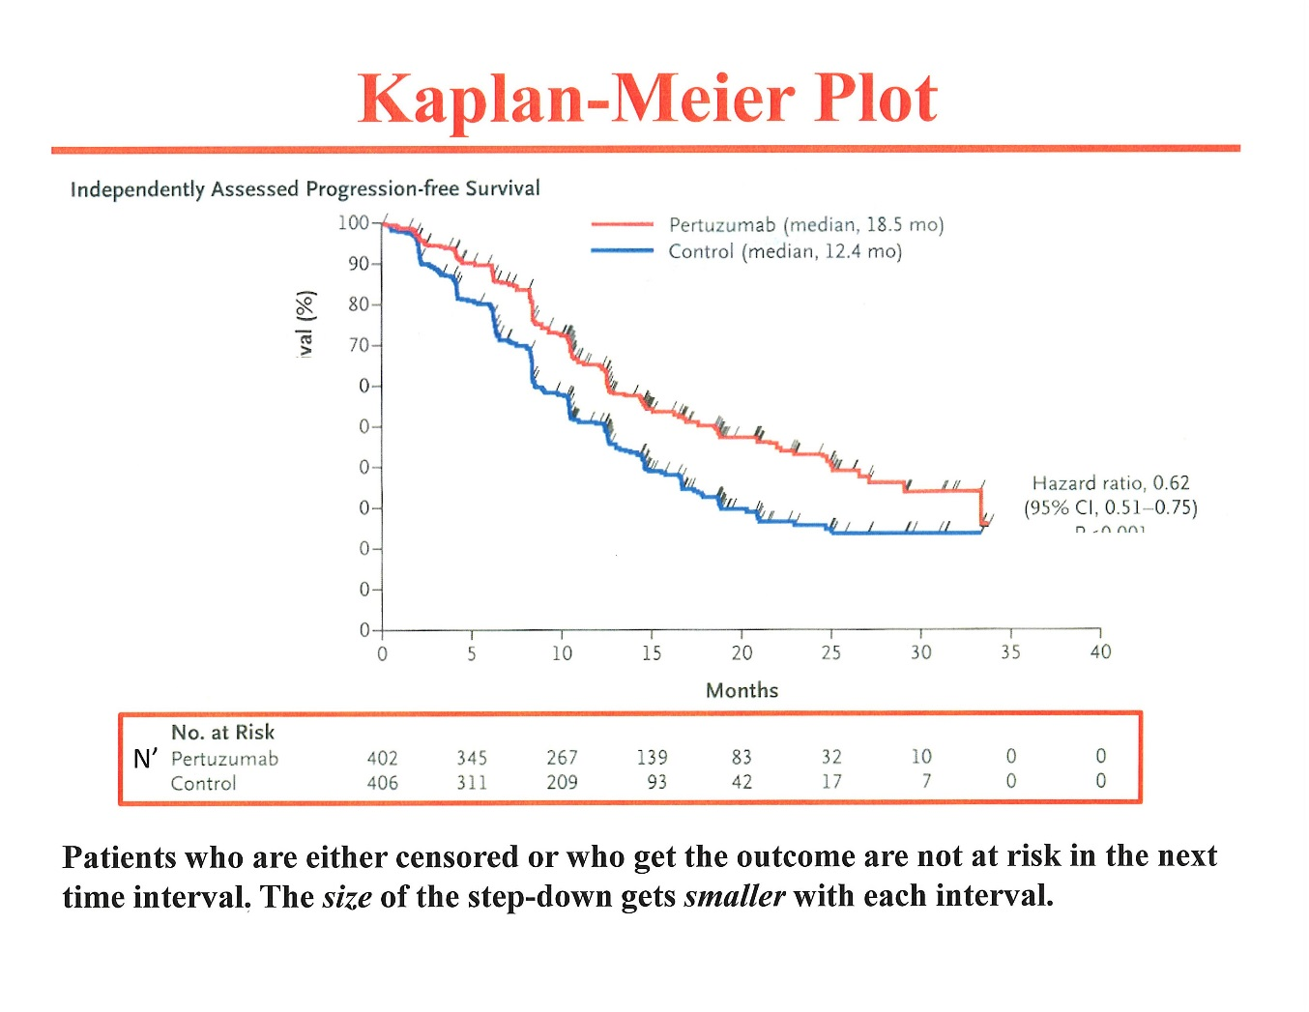
COX
MODEL
Survival (%)

Slide 53
Observed (O) vs Expected (E) Outcomes over time as the Basis for the Cox Model
    ΣO_{group 1}/ΣE_{group 1}
    ΣO_{group 2}/ΣO_{group 2}
HR=
=
a/b
c/d
Σ_{1-i} , sum of the outcomes over the time periods 1 to i

